Slide 1
BACS2163 SOFTWARE ENGINEERING
Online Food Ordering System: Sushi Mentai
RSD G5
Ong Yi Xin
Ng Ian Kai
Chia Ming Yi
Lim Jun Wei

Slide 2
1.1 Organization Background

Slide 3
1.1 Organization Background
Japanese Food Restaurant
Founded: Group of passionate entrepreneurs in 2017
Up to 50 outlet in Malaysia & Singapore
Variety of japanese dishes
Keep price reasonable while maintaining quality

Slide 4
1.1 Organization Background
Urgent require system
Reason:
only have food ordering function via WhatsApp
No cooperate with food delivery organization

Slide 5
1.2 Requirement Gathering Techniques

Slide 6
Questionnaire
Why?
Time Effective
Privacy Concern
Cost-Effectiveness
Standardization
Information Gathered
Method of online ordering food preferred
Satisfaction of current implemented online food ordering methodology
Feedback concerned about integrity of food menu information
Possible improvement of system

Slide 7
Observation
Why?
Realistic Data Collection
Determination of Errors and Inefficiencies
Profound Requirement Description
Detection of Emotion Changes
Information Gathered
Lack of customer support for users
Lack of availability of menu food items

Slide 8
1.3 Problems of Existing System

Slide 9
Limited Online Ordering Channel
No online ordering on the website, only via WhatsApp.
Prone to miscommunication and order errors.
Manual handling leads to slow responses, especially during peak hours.
Customer frustration due to delays and abandoned orders.

Slide 10
Inadequate Customer Support
No dedicated online support system.
Delays in resolving issues and answering queries.
Lack of feedback tracking leads to unresolved problems.
Customers feel neglected, reducing satisfaction and loyalty.

Slide 11
Incomplete Menu Information
Missing prices on many items.
Unclear pricing discourages orders and complicates decisions.
Customers must contact the restaurant for pricing.
Lack of price transparency leads to slow orders and frustration.

Slide 12
Poor Menu Layout
Difficult navigation between multiple pages.
Hard to compare items, leading to abandoned orders.
Limited exposure to new items and promotions.
Inefficient layout reduces satisfaction.

Slide 13
Lack of Availability Status
No real-time status for item availability.
Customers are frustrated when items are unavailable.
Damaged trust due to repeated unavailability.
Manual updates by staff cause inefficiencies.

Slide 14
1.4 Software Quality Attributes

Slide 15
5 Chosen Software Quality Attributes
Software Quality Attribute | Explanation
Availability | The probability that a system will work as required when required during the period of a mission.
Functional | The system will perform the functions that it is required to.
Usable | Provide users with a satisfying experience (not a source of dissatisfaction).
Reliable | Not prone to hardware or software failures, the system will deliver the functionalities when the users want it.
Flexible | Capable of being adapted to new users, to run in different countries or to be moved to a different platform.

Slide 16
1.5 Software Process Model

Slide 17
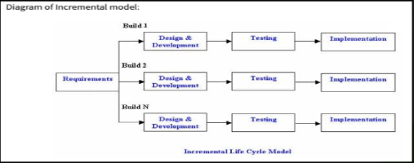
Incremental Model
Break requirements down into standalone modules
Each module passes through phases:
Requirements
Design
Implementation
Testing
Improved system via repeating phases

Slide 18
Incremental Model
System introduced in 10 weeks
First Build:
View item menu
Register as member
Manage staff (add / update staff info)
Second Build:
Food ordering service
Payment
Table reservation
Third Build:
Delivery service
Membership function
Report generation
Promotion function

Slide 19
Incremental Model
Comprehensive requirements of system
Core requirement: Allow customer to use fundamental food ordering service
Secondary requirement:
Delivery service
Customer support live chat
Event posting

Slide 20
Incremental Model
Quick Introduction into Market
Introduced into Market within 10 weeks
First increment focuses on:
Core requirement and functionalities of system
E.g. View menu, add to cart, place order, payment, view receipts
Second increment focuses on:
Sub requirement of system
E.g. Delivery feature, customer service live chat, event posting features

Slide 21
2.1 Project Planning & Scheduling

Slide 22
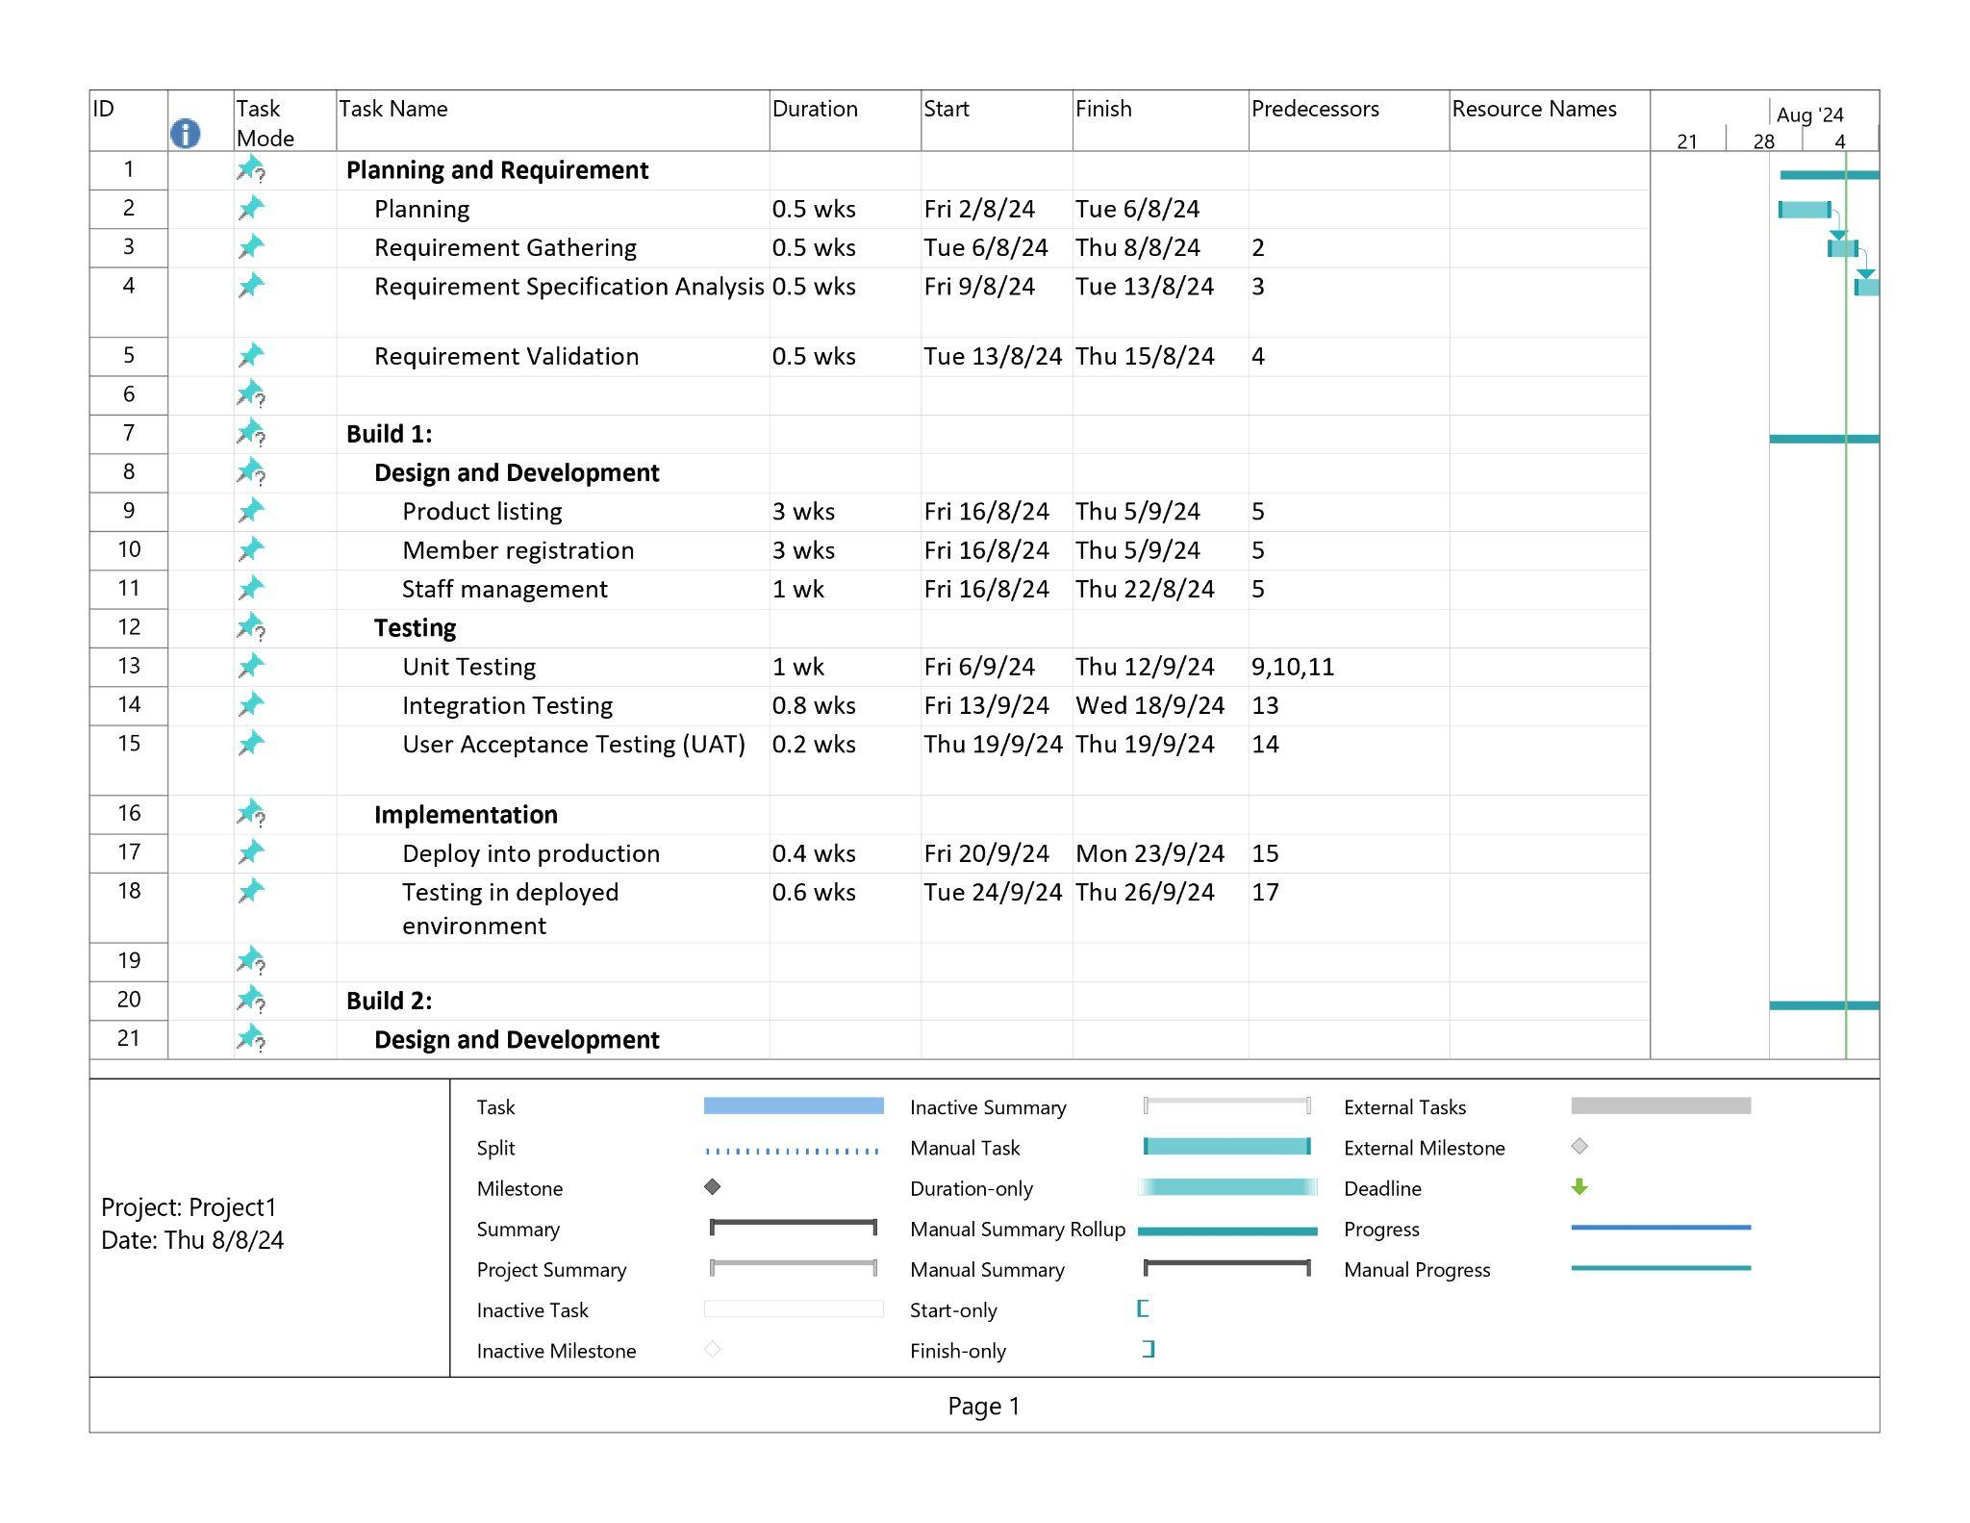
Project Planning & Scheduling

Slide 23
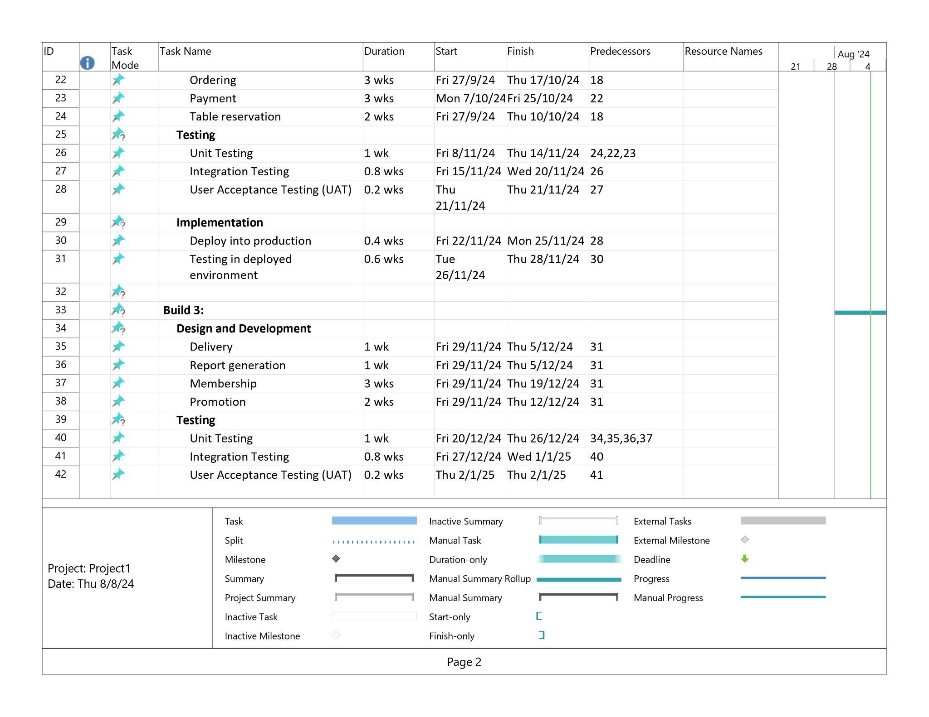
Project Planning & Scheduling

Slide 24
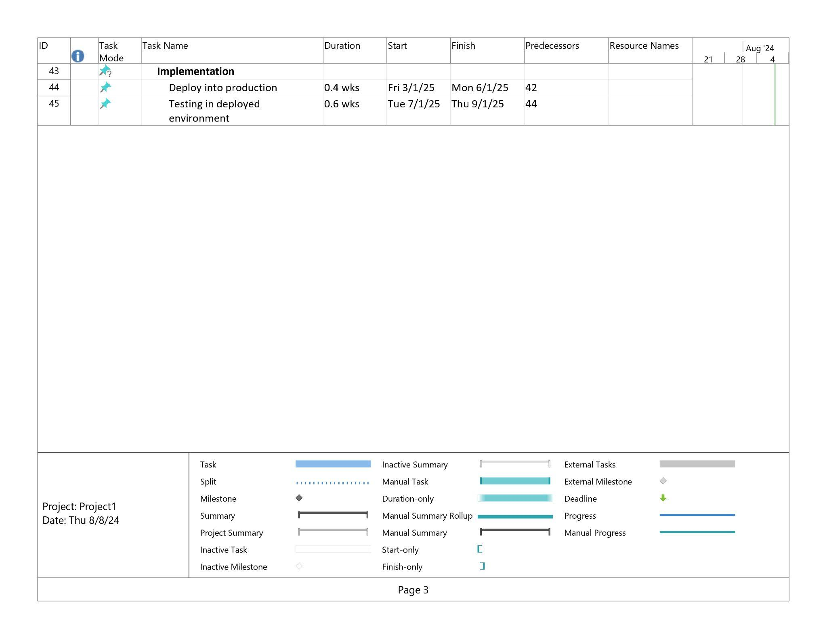
Project Planning & Scheduling

Slide 25
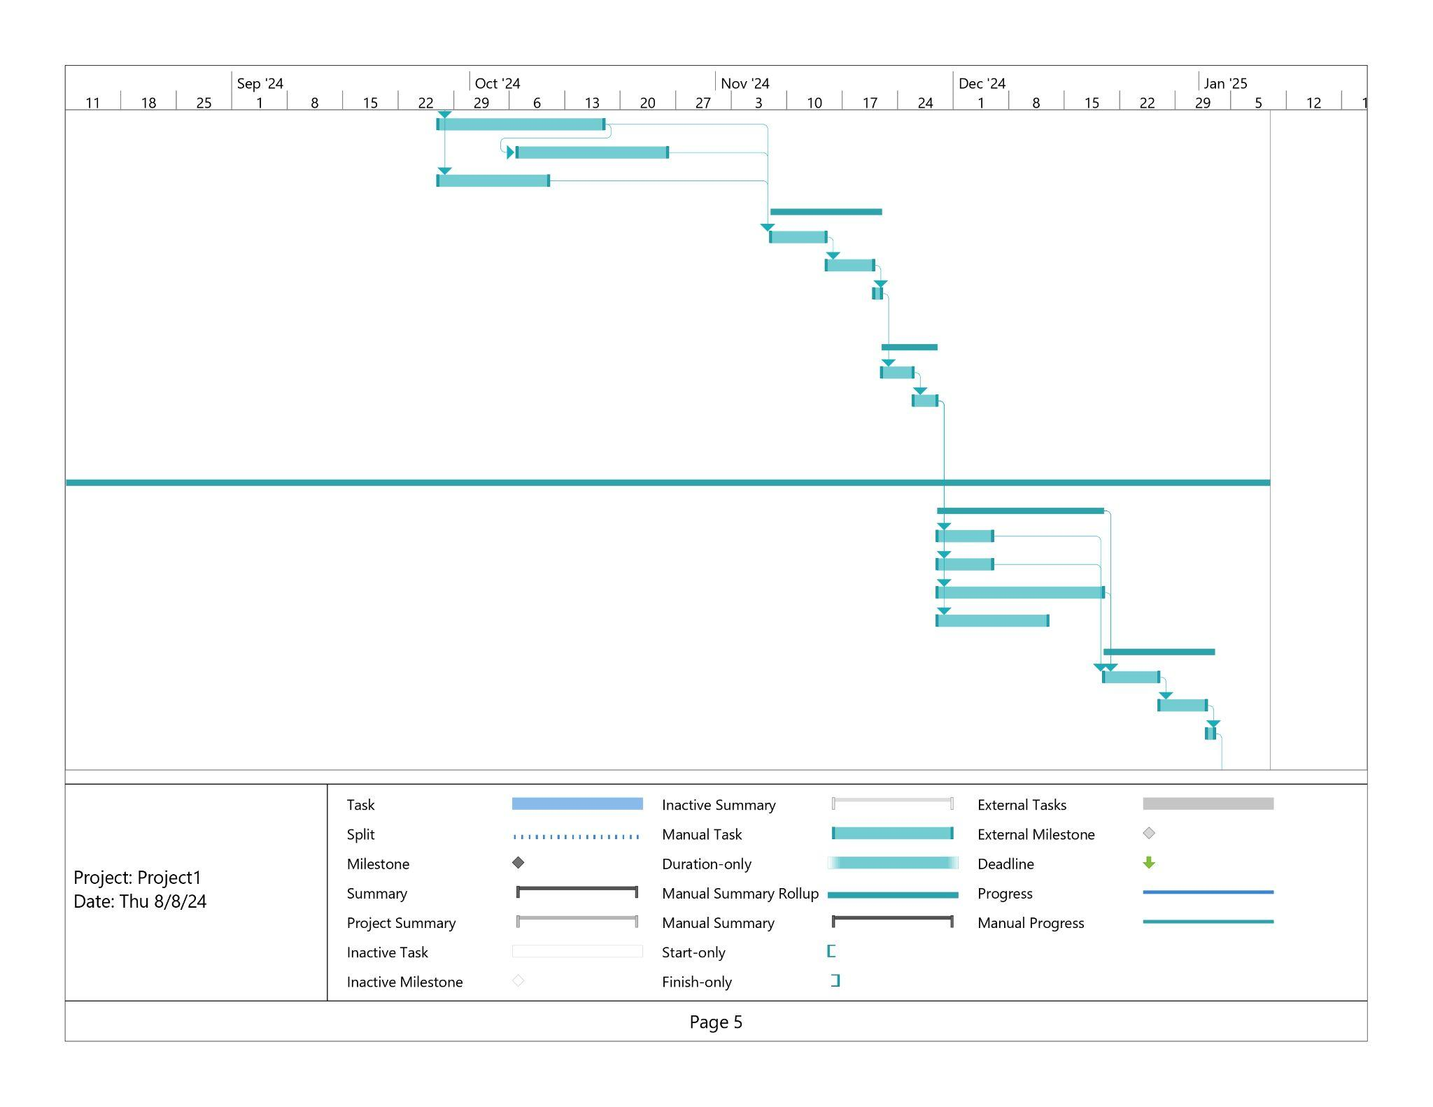
Project Planning & Scheduling

Slide 26
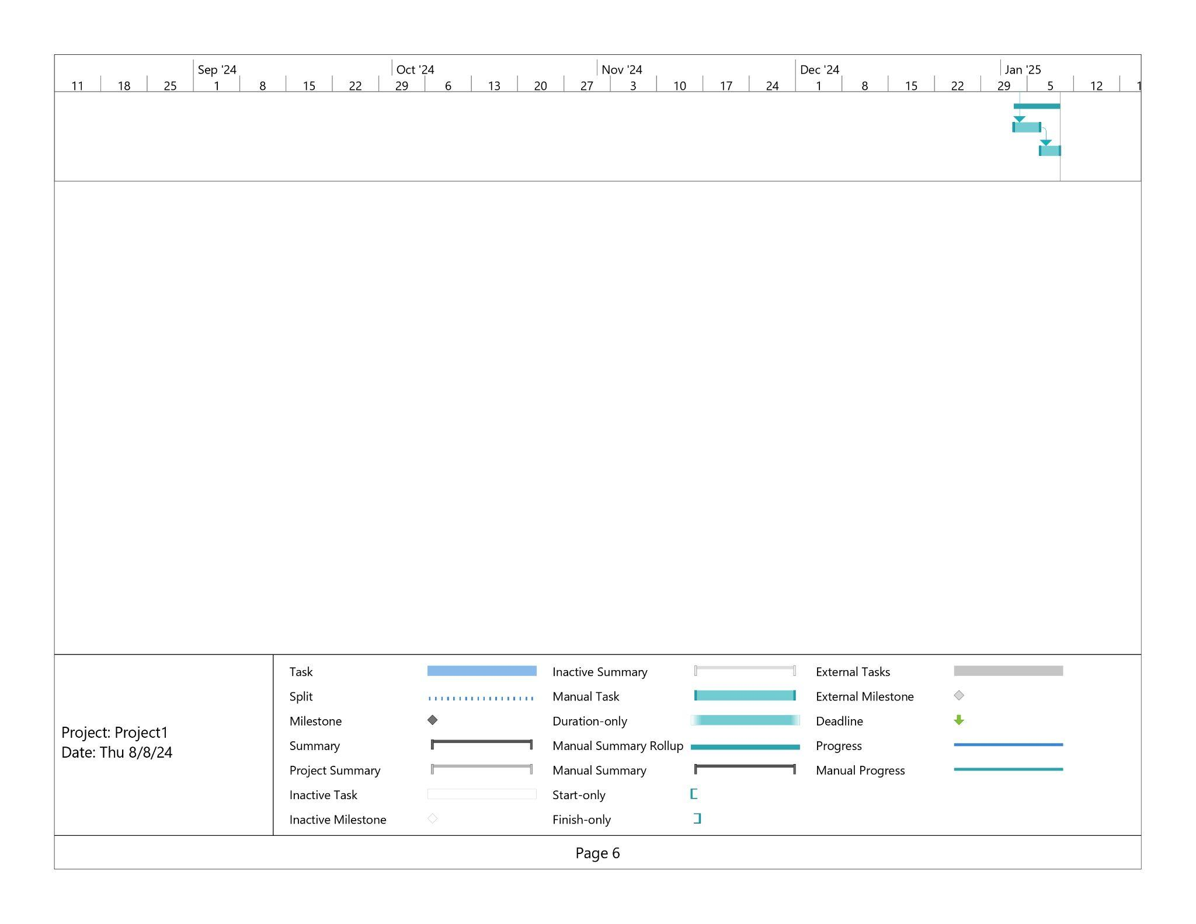
Project Planning & Scheduling

Slide 27
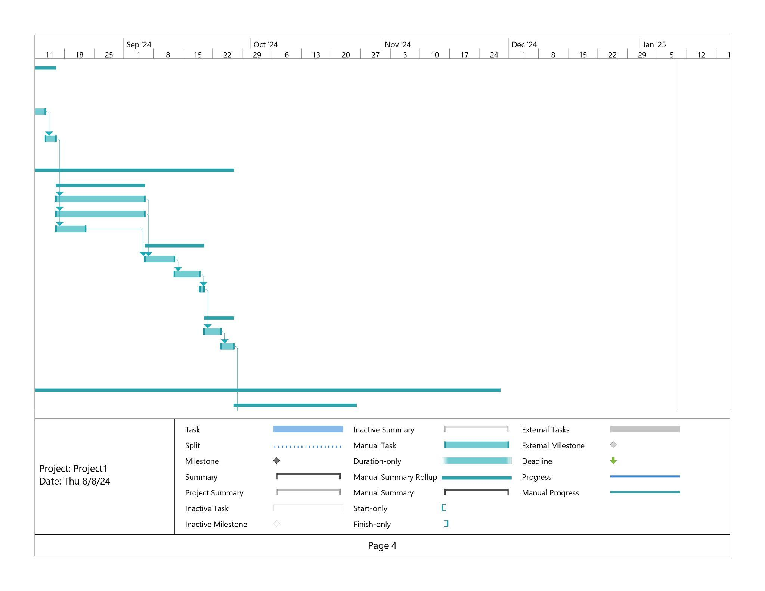
Project Planning & Scheduling

Slide 28
2.2 System Requirement (Functional Requirement)

Slide 29
Order (Ong Yi Xin)
1.0 Add to Cart Function
1.1 The system shall allow users to select items from the menu to add to their cart.
1.2 The system shall prompt users to specify the quantity of each selected item.
1.3 The system shall allow users to add special instructions for each item .
1.4 The system shall add the selected items and quantities to the user's cart.
1.5 The system shall display a confirmation message when items are successfully added to the cart.
1.6 The system shall update the cart summary to reflect the newly added items.
1.7 The system shall display the subtotal cost of items in the cart.
1.8 The system shall support updating item quantities or removing items from the cart after addition.

Slide 30
Order (Ong Yi Xin)
2.0 View Cart Function
2.1 The system shall display a detailed list of items currently in the cart, including names, quantities, and prices.
2.2 The system shall show the total cost of the items in the cart.
2.3 The system shall allow users to modify quantities of items in the cart.
2.4 The system shall allow users to remove items from the cart.
2.5 The system shall show the updated total cost when items are added or removed.
2.6 The system shall provide an option to apply discount codes or promotional offers.
2.7 The system shall allow users to view and edit special instructions for each item in the cart.
2.8 The system shall prompt users to review their order before proceeding to checkout.

Slide 31
Order (Ong Yi Xin)
3.0 Place Order Function
3.1 The system shall prompt users to review their complete order before submission.
3.2 The system shall allow users to confirm and submit their order.
3.3 The system shall provide an order confirmation with a unique order ID.
3.4 The system shall display an estimated preparation time for the order.
3.5 The system shall allow users to select payment methods (e.g., credit card, cash).
3.6 The system shall provide a summary of payment details and total cost.
3.7 The system shall confirm successful order submission and provide an option to print or save the order receipt.
3.8 The system shall update the order status to "Processing" and notify users of the status.

Slide 32
Order (Ong Yi Xin)
4.0 Cancel Order Function
4.1 The system shall allow users to cancel their order before it is being processed.
4.2 The system shall prompt users to confirm the cancellation request.
4.3 The system shall update the order status to "Canceled" upon successful cancellation.
4.4 The system shall provide a confirmation message once the order is canceled.
4.5 The system shall handle refunds if applicable, based on the restaurant’s policy.
7.6 The system shall notify users of any potential issues or restrictions regarding the cancellation.
4.7 The system shall allow users to view the cancellation details and reason.

Slide 33
Delivery and Track Order (Ong Yi Xin)
1.0 Schedule Delivery
1.1 The system shall allow users to choose a delivery date from available slots.
1.2 The system shall allow users to choose a delivery time from available slots.
1.3 The system shall validate that the selected delivery time is within the restaurant's operational hours.
1.4 The system shall allow users to schedule delivery for a future date or time.
1.5 The system shall confirm the scheduled delivery time and date to the user.
1.6 The system shall provide an option for users to reschedule the delivery time before the order is processed.
1.7 The system shall send a confirmation email with the scheduled delivery details.

Slide 34
Delivery and Track Order (Ong Yi Xin)
1.0 Schedule Delivery
1.8 The system shall notify users of any delays to the scheduled delivery time.
1.9 The system shall notify users of any changes to the scheduled delivery time.
1.10 The system shall allow users to select delivery preferences.

Slide 35
Delivery and Track Order (Ong Yi Xin)
2.0 Enter Delivery Address
2.1 The system shall allow users to enter a new delivery address.
2.2 The system shall allow users to select from saved addresses.
2.3 The system shall validate the address format to ensure it is complete and accurate.
2.4 The system shall provide address suggestions based on user input.
2.5 The system shall provide address auto-completion based on user input.
2.6 The system shall allow users to edit the delivery address before finalizing the order.
2.7 The system shall save frequently used addresses for easy future use.

Slide 36
Delivery and Track Order (Ong Yi Xin)
2.0 Enter Delivery Address
2.8 The system shall display the entered address for user verification.
2.9 The system shall confirm the entered address for user verification before proceeding.
2.10 The system shall notify users if the entered address is outside the delivery area.
2.11 The system shall provide an option to specify delivery instructions.

Slide 37
Delivery and Track Order (Ong Yi Xin)
3.0 Delivery Charges
3.1 The system shall calculate delivery charges based on the delivery address and order amount.
3.2 The system shall display the calculated delivery charges before the order is finalized.
3.3 The system shall apply any available promotional discounts to the delivery charges.
3.4 The system shall update the total cost to include delivery charges.
3.5 The system shall reflect the updated total cost in the order summary.
3.6 The system shall provide an option to choose a delivery method.
3.7 The system shall notify users for additional charges for specific delivery options or addresses.
3.8 The system shall include a breakdown of delivery charges in the final order summary.

Slide 38
Delivery and Track Order (Ong Yi Xin)
4.0 View Order Status
4.1 The system shall display the current status of the order.
4.2 The system shall provide an estimated time of arrival for the order.
4.3 The system shall update the order status in real-time.
4.4 The system shall provide a visual representation of the order status.
4.5 The system shall notify users of significant status changes via email.
4.6 The system shall allow users to view historical status changes for their orders.

Slide 39
Delivery and Track Order (Ong Yi Xin)
4.0 View Order Status
4.7 The system shall allow users to view timestamps for their orders.
4.8 The system shall provide detailed information about each status update, including reasons for delays if applicable.
4.9 The system shall allow users to contact support if there are discrepancies or issues with the order status.

Slide 40
Delivery and Track Order (Ong Yi Xin)
5.0 Order History
5.1 The system shall provide users with access to their pass order.
5.2 The system shall display details for each past order.
5.3 The system shall allow users to search and filter their order history by date.
5.4 The system shall allow users to search and filter their order history by status.
5.5 The system shall provide a summary of previous orders with the option to view more details.
5.6 The system shall display order history in a list.
5.7 The system shall allow users to re-order items from their order history.
5.8 The system shall provide users with options to export their order history.
5.9 The system shall ensure that the order history is secure and accessible only to the user.

Slide 41
Delivery and Track Order (Ong Yi Xin)
6.0 Order Tracking
6.1 The system shall provide a unique tracking number for each order.
6.2 The system shall display real-time tracking information provided by the delivery service.
6.3 The system shall update tracking information periodically.
6.4 The system shall provide an estimated delivery route.
6.5 The system shall allow users to view detailed tracking history.
6.6 The system shall allow users to view delivery updates.
6.7 The system shall notify users of any significant changes or delays in the tracking status.

Slide 42
Delivery and Track Order (Ong Yi Xin)
6.0 Order Tracking
6.8 The system shall notify users of delays in the tracking status.
6.9 The system shall allow users to report issues with the tracking information.
6.10 The system shall ensure that tracking information is accurate and up-to-date.

Slide 43
Product (Chia Ming Yi)
1.0 View Product
1.1 The system shall display a list of all products.
1.1 The system shall display detailed information for each product, including name, description, price, and images.
1.2 The system shall display the products in categories.
1.3 The system shall allow users to enter product name to search for products.
1.4 The system shall allow users to filter the product items displayed in product list.

Slide 44
Product (Chia Ming Yi)
2.0 Create Product
2.1 The system shall allow staff to create new products.
2.2 The system shall allow staff to enter a new product name, cost and price.
2.3 The system shall allow staff to upload a product image.
2.4 The system shall check the format of the new products’ data.
2.5 The system shall display the error messages when the users’ input is incorrect.
2.6 The system shall update the system database when there are new or updated product details.

Slide 45
Product (Chia Ming Yi)
3.0 Update Product
3.1 The system shall show the current details of the selected product.
3.2 The system shall allow staff to modify the existing products’ name, images, quantity, cost and price.
3.3 The system shall check the format and the size of uploaded files.
3.4 The system shall validate the format of the updated product details.
3.5 The system shall display error messages when there is incorrect users’ input.
3.6 The system shall display confirmation dialog to users before saving updated product details.
3.7 The system shall allow users to confirm the product update action.

Slide 46
Product (Chia Ming Yi)
3.0 Update Product
3.8 The system shall display successful messages to user after successful updating product details.
3.9 The system shall allow staff to delete products.
3.10 The system shall allow staff to list or delist the products.
3.11 The system shall update the system database when there are new or updated product details.

Slide 47
Product (Chia Ming Yi)
4.0 Navigate the Menu of Products
4.1 The system shall display real-time product availability status.
4.2 The system shall allow users to exclude products that contain their allergies.
4.3 The system shall allow users to browse products by categories.
4.4 The system shall allow users to search for products by any keywords.
4.5 The system shall allow users to filter products by price range and category.
4.6 The system shall display search results based on user queries.
4.7 The system shall display product recommendations based on user preferences and purchase history.
4.8 The system shall allow users to view the product details page for the selected product.
4.9 The system shall display other related products on the product detail page.

Slide 48
Product (Chia Ming Yi)
5.0 Post Reviews and Ratings
5.1 The system shall allow users to submit reviews for products.
5.2 The system shall allow users to rate products.
5.3 The system shall display product reviews and ratings to users.
5.4 The system shall check the validity of product reviews.
5.5 The system shall allow users to upload multiple images or video files.
5.6 The system shall validate the format and size of the uploaded files.
5.7 The system shall allow staff to delete customers’ reviews.

Slide 49
Payment (Chia Ming Yi)
1.0 Authenticate user
1.1 The system shall authenticate users before allowing access to the payment module.
1.2 The system shall support multiple authentication methods.
2.0 Process payment
2.1 The system shall support payments in multiple currencies.
2.2 The system shall display payment amounts in the user's preferred currency.
2.3 The system shall allow users to select their preferred currency.
2.4 The system shall calculate the total payment amount based on the selected order item.
2.5 The system shall allow users to enter their bank account ID and password.

Slide 50
Payment (Chia Ming Yi)
2.0 Process payment
2.6 The system shall check the validity of bank account ID and password.
2.7 The system shall display the error messages when users’ provided information is incorrect.
2.8 The system shall allow users to select “Yes” or “No” option before confirming payment.
2.9 The system shall display successful messages to users after completing payment.

Slide 51
Payment (Chia Ming Yi)
3.0 Generate receipts and notifications
3.1 The system shall generate receipts for successful payments.
3.2 The system shall allow users to download the receipts.
3.3 The system shall send email receipts to users.
3.4 The system shall push notifications for completed transactions.
3.5 The system shall send SMS confirmations for completed transactions.
4.0 View transaction history
4.1 The system shall allow users to view their transaction history.
4.2 The system shall allow users to filter the transaction history.
4.3 The system shall allow users to search for transactions.

Slide 52
Payment (Chia Ming Yi)
5.0 Process refunds
5.1 The system shall allow users to request refunds within 12 hours.
5.2 The system shall allow users to enter reason when requesting refunds.
5.3 The system shall check the validity of the reason field.
5.4 The system shall allow users to upload image and video files.
5.5 The system shall validate the format of the uploaded files.
5.6 The system shall display error messages when users have entered incorrect data.
5.7 The system shall allow staff to view user refund requests.
5.8 The system shall allow staff to search the refund records.

Slide 53
Payment (Chia Ming Yi)
5.0 Process refunds
5.9 The system shall allow staff to approve or deny user refund requests.
5.10 The system shall allow staff to enter remarks for refund records.
5.11 The system shall display the request status to the user.
5.12 The system shall update the refund status after approving or denying user refund requests.
5.13 The system shall automatically transfer the money to users’ account once the refund request has been approved.

Slide 54
Table Reservation (Lim Jun Wei)
1.0 Reserve table in restaurant
1.1 The system shall display the available tables, time slots for the selected date and time and available location of restaurants.
1.2 The system shall allow users to enter the number of customers for each reservation.
1.3 The system shall update the table availability from time to time.
1.4 The system shall allow users to enter their mobile number.
1.5 The system shall verify the mobile number.
1.6 The system shall allow users to select the location of restaurants.
1.7 The system shall verify the availability of the restaurants.
1.8 The system shall allow users to select the available time slot for each reservation.
1.9 The system shall display the error messages when users’ input is wrong.
1.10 The system shall send the reservation confirmation message to the users.

Slide 55
Table Reservation (Lim Jun Wei)
2.0 Track the table reservation
2.1 The system shall allow users to track the current status of their reservation.
2.2 The system shall allow users to view the reservation details.
2.3 The system shall update the reservation status to the users real-time.
2.4 The system shall provide the phone number and email address as contact details to users.
2.5 The system shall send notification to the users before 1 hour from the table reservation time.
2.6 The system shall show the location of the restaurant which has been reserved by the users.
2.7 The system shall display the table number reserved by the users.

Slide 56
Table Reservation (Lim Jun Wei)
3.0 Update table reservation
3.1 The system shall prevent users from updating the table reservation which has been created over 3 hours.
3.2 The system shall display the reservation update form to the users.
3.3 The system shall allow users to enter the mobile number, date and time of reservation and location of the restaurant.
3.4 The system shall check the validity of the mobile number, date and time of reservation and location of the restaurant.
3.5 The system shall display the confirmation dialog to the users.
3.6 The system shall update the latest reservation information to the system database.
3.7 The system shall send the successful update reservation notification to users via email or SMS.
3.8 The system shall allow users to cancel the reservation.

Slide 57
Member Registration (Lim Jun Wei)
1.0 Register as member
1.1 The system shall allow users to enter their name, mobile number, email address and password.
1.2 The system shall verify the users’ mobile number.
1.3 The system shall check the valid format of users’ email address.
1.4 The system shall check the validity of users’ passwords.
1.5 The system shall prompt error messages and remind the users to re-enter the valid input.
1.6 The system shall send verification email or One-Time-Password to users’ email or SMS.
1.7 The system shall require users to accept the terms and conditions and privacy policy before completing registration.
1.8 The system shall store member’s registration details into the system database.
1.9 The system shall notify the users when they have registered as members successfully.

Slide 58
Member Registration (Lim Jun Wei)
2.0 Integrating with social media platforms
2.1 The system shall allow users to choose the social media platform account to be integrated with.
2.2 The system shall redirect users to the social media platform login page.
2.3 The system shall allow users to enter the email address, username and password for the social media account.
2.4 The system shall check the validity of the media social account credentials input.
2.5 The system shall display error messages and prompt users to re-enter the valid credentials if they have provided incorrect credentials.
2.6 The system shall store the integrated social media account credentials into the system database.
2.7 The system shall display the successful integration message to users via email.

Slide 59
Member Registration (Lim Jun Wei)
3.0 Recover password
3.1 The system shall allow users to enter their mobile phone number or email address.
3.2 The system shall check whether the mobile phone number or email address exists in the system database.
3.3 The system shall display error messages if the mobile phone number or email address is not valid.
3.4 The system shall send verification email or One-Time-Password via SMS to users.
3.5 The system shall allow users to click the verification link embedded in email.
3.6 The system shall allow users to enter One-Time-Password in the provided form.
3.7 The system shall verify the One-Time-Password entered by users.
3.8 The system shall refuse the One-Time-Password if it is incorrect or expired.
3.9 The system shall allow users to enter the new password for their accounts.
3.10 The system shall display a successful message to users via email or SMS if their password has been recovered successfully.

Slide 60
Membership (Ng Ian Kai)
1.0 Update Membership Points Balance
1.1 The system shall update the user’s membership points balance upon receiving successful order information from the payment module.
1.1.1 The system shall verify the accuracy of the points calculation based on a predefined rule of how many points per currency unit.
2.0 View Membership Points Balance
2.1 The system shall allow users to view their current membership points balance.
2.2 The system shall show the expiration date of how many points when user hovered over the points balance
2.3 The system shall show alerts when the user has points that are about to expire.

Slide 61
Membership (Ng Ian Kai)
3.0 View Points History
3.1 The system shall allow users to view a detailed points history of points earned and points redeemed.
3.1.1 The detailed points history shall be displayed as a table with the columns as “Date”, “Type”, “Action”, “Points”, and “Status”.
3.2 The system shall allow users to filter the detailed points history by date.
3.3 The system shall provide advanced filtering options including filter by type (earned/ redeemed), status (approved, pending), and points amount.
3.4 The system shall allow users to sort the detailed points history by date, type, points amount, and status.

Slide 62
Membership (Ng Ian Kai)
4.0 Display Voucher Catalog
4.1 The system shall display a catalog of vouchers available for redemption using membership points.
4.2 The system shall allow users to browse through the voucher catalog.
4.3 The system shall allow users to view detailed information about each voucher, including points required, validity period, and terms of use.
4.4 The system shall allow users to search vouchers by name.
4.5 The system shall allow users to filter vouchers by points required and expiration date.
4.6 The system shall update the voucher catalog in real-time to reflect availability and expiration of vouchers.

Slide 63
Membership (Ng Ian Kai)
5.0 Redeem Vouchers
5.1 The system shall allow users to redeem vouchers using their membership points.
5.2 The system shall verify the availability and validity of the selected voucher before confirming redemption.
5.3 The system shall display an appropriate error message when the users have insufficient points for the selected redemption.
5.4 The system shall deduct the appropriate number of points from the user’s membership points balance upon successful redemption.
5.5 The system shall display a confirmation message when the voucher is successful redeemed.

Slide 64
Promotion (Ng Ian Kai)
1.0 Display Promotion List
1.1 The system shall display a list of promotions for users to view.
1.2 The system shall display additional buttons only for staff to add, modify, and remove promotions.
2.0 Add New Promotion
2.1 The system shall allow staff to add a new promotion to the system.
2.2 The system shall allow staff to specify key promotion details such as start date, end date, eligibility criterias, discount value, associated products, and redemption limits.
2.3 The system shall display an error message if any mandatory promotion details are missing before adding the promotion.
2.3.1 The mandatory promotion details include start date, end date, discount values, and associated products.
2.3.2 The non-mandatory promotion details including eligibility criterias and redemption limits, shall be defaulted to anyone is eligible and no redemption limits, respectively.
2.4 The system shall display a confirmation message when a promotion is successfully added.

Slide 65
Promotion (Ng Ian Kai)
3.0 Modify Existing Promotion
3.1 The system shall allow staff to search for existing promotions by name.
3.2 The system shall allow staff to filter existing promotions by validity, discount values, and associated products.
3.2.1 The promotion’s validity shall be determined by the start date, end date, and redemption limit, and associated products quantity.
3.3 The system shall allow staff to select an existing promotion for modification.
3.4 The system shall allow staff to modify the existing promotion’s details including start date, end date, eligibility criteria, discount value, associated products, and redemption limits.
3.5 The system shall display an error message if mandatory promotion details are missing during modification.
3.5.1 The mandatory promotion details include start date, end date, discount values, and associated products.
3.5.2 The non-mandatory promotion details including eligibility criterias and redemption limits, shall be defaulted to anyone is eligible and no redemption limits, respectively.
3.6 The system shall display a confirmation message when a promotion is successfully modified.

Slide 66
Promotion (Ng Ian Kai)
4.0 Remove Existing Promotion
4.1 The system shall allow staff to search for existing promotions by name.
4.2 The system shall allow staff to filter existing promotions by validity, discount values, and associated products.
4.2.1 The promotion’s validity shall be determined by the start date, end date, and redemption limit, and associated products quantity.
4.3 The system shall allow staff to select existing promotions for removal.
4.4 The system shall display a confirmation prompt before removing a promotion.
4.3 The system shall display a confirmation message when a promotion is successfully removed.

Slide 67
Promotion (Ng Ian Kai)
5.0 Promotion Notifications
5.1 The system shall notify users of upcoming promotions that are about to start.
5.2 The system shall notify users of ongoing promotions that are about to expire.
5.3 The system shall send notifications of promotions only to eligible users.

Slide 68
2.3 Non-Functional Requirements

Slide 69
Product
1.0 Availability
1.1 The new system shall be available 99.95% of the time, ensuring minimal downtime.
1.2 The new system’s scheduled maintenance shall be limited to non-peak hours and should not exceed 2 hours per month.
1.3 In the event of unexpected server downtime, the system should recover and be fully operational within 5 minutes.
2.0 Functional
2.1 The new system shall ensure that all functionalities are accessible and functioning as expected across all platforms and devices, including different operating systems and different device types.

Slide 70
Product
3.0 Useable
3.1 The new system shall have a user interface that is intuitive and easy to use, allowing even novice users to make orders without requiring external assistance.
3.2 The new system shall maintain consistency in user interface design across all pages and platforms, including mobile devices and desktop devices.
4.0 Reliable
4.1 The new system shall be able to handle up to 20,000 concurrent users without noticeable degradation of performance.
4.2 The system shall ensure data integrity during payment transactions, with no loss of information even in case of system failure.
5.0 Flexible.
5.1 The system shall support localization, enabling it to be run seamlessly in varying countries, by allowing easy translation of text, adaption to date format, and currency conversions.

Slide 71
Organization & External
Organization: delivery, implementation, standards
The system should be developed using PHP programming language with Laravel framework.
The system should use the MySQL database management system to store system data.
External
The system must be able to process payments through major payment gateways like PayPal and Stripe.
The system shall ensure compliance with the Payment Card Industry Data Security Standard (PCI DSS) for handling payment information.

Slide 72
2.4 View-Point Oriented Analysis

Slide 73
Customer (Ong Yi Xin)
Role
Primary user
Decision makers
Feedback providers
Use
Place order
Membership features

Slide 74
Customer (Ong Yi Xin)
Importance
Impact on usability and design
Needs and preferences
Make system more personal
Personalize function
Generate revenue

Slide 75
Manager (Lim Jun Wei)
Oversee analysis report
Monitor and evaluate performance of system and organization
Discuss and decide direction of system UI design
Plan improvement action on creating more user-friendly interface design
Decide resources allocation for each section of organization

Slide 76
Auditor (Chia Ming Yi)
Ensuring Legal Compliance
Financial Oversight
Security Assessments
Improving Operational Efficiency
Risk Management

Slide 77
Marketing Staff (Ng Ian Kai)
View point importance is in the planning and designing of marketing strategies
Goals
Attract more customers
Retain existing returning customers
Remain competitive
Enhance customer loyalty
Example of marketing strategies
A membership points reward system that incentivizes customers on successful orders.
Planning promotions and events that drive customer traffic.

Slide 78
3.1 An Architectural Design

Slide 79
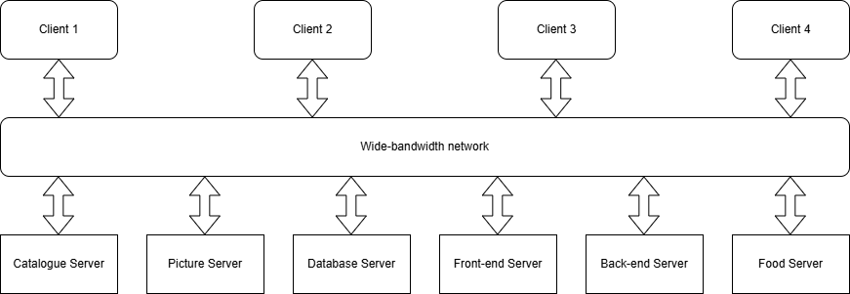
Client-Server Model

Slide 80
Client-Server Model
Catalogue Server
Customers: View available food items in restaurant
Staff: Create, view, modify and delete food items data

Slide 81
Client-Server Model
Picture Server
Hosts and serves images
Serves images and presents them on customers’ food menu page
Restaurant logo images and shows on system user interface
Advertisement, deals and special offers images
Images uploaded by customers

Slide 82
Client-Server Model
Database Server
Stores sensitive information of system or restaurants
Personal information: name, gender, ages, passwords
Restaurant data: names, locations, operating hours, reviews
Customers order history
Delivery details of customers’ order

Slide 83
Client-Server Model
Front-End Server
Provides user interfaces and handling interaction between users and system
Stores front-end pages design components, e.g. font, assets, icons, codes
Handles basic operation initiated by users
Acts as intermediary to send requests to back-end server
Receives responses from back-end server
Offers excellent user experiences

Slide 84
Client-Server Model
Back-End Server
Receives input from front-end server
Processes data when dealing with database
Sends response back to front-end server
Processes order creation
Processes payment

Slide 85
Client-Server Model
Food Server
Tracks and manages orders
Real-time update the latest order and show order on system interface
Update order status via interacting with interface

Slide 86
Client-Server Model
Justification
Straightforward data distribution
Immediate update on data in respective servers to ensure system consistency
Cost-effective via effective use of networked systems
Perform heavy computations efficiently with low cost and less powerful servers
Easily adapt to different requirements of users amount

Slide 87
3.2 Test Plan

Slide 88
Test Objective
Ensures the system is able to perform all functionalities without causing any errors
Determines existing errors in system
Fixes errors and maintains system reliability and performance

Slide 89
Testing Process: Unit Testing
Breaks the whole system functionalities down into single individual components
Test them one by one
In our case, we may test:
Add food items into cart with different test input data
Enter delivery address with different length and characters of data

Slide 90
Testing Process: Module Testing
Tests on individual modules or collection of components
Ensure all functions in module work properly & fulfil requirements
In our case, we may test:
Integrate “manage product information”, “navigate menu of products” and “post reviews and ratings” into one module
Then, test the functionalities in the module

Slide 91
Testing Process: Sub-System Testing
Tests collection of modules which have been integrated into sub-system
Determine how different modules are interacting with each other in terms of data flow and error handling
In our case, we may test:
Combine all modules into 2 subsystems which are customers’ sub-system and staff sub-system
Test the sub-systems
Determine how operability and reliability of real-time data flows between subsystems

Slide 92
Testing Process: System Testing
Checks compatibility of individual modules
Test integration of each sub-system in the entire system
In our case, we may test:
Conduct system testing from top to bottom
Include all applicable and approachable test scenarios, e.g. users login to system → users track order status
Simulate real life usage environment

Slide 93
Testing Process: User Acceptance Testing (UAT)
Final stage in testing process before system is accepted for operational use
Involves actual end-users or stakeholders
Ensure expectations or requirements are fulfilled
In our case, we may test:
Actual users use the system like how they use it in real-world or actual situation
Users will offer formal approval or “sign-off” once all criterias have been approached

Slide 94
Tested Items
Add item to cart
Schedule delivery time of an order
Process Payment
Create new product
Reserve table in restaurant
Register as member
Update membership points balance
Add new promotion

Slide 95
Testing Techniques
Testing Stages | Techniques
Unit Testing Stage | Component/ Unit testing (Individual function in an object)
Module Testing Stage | White Box testing
Sub-system Testing Stage | Bottom-Up testing
System Testing Stage | Regression testing (For incremental model)
User Acceptance Testing Stage | Black-Box testing (Pre-release)

Slide 96
Testing Environment
Operating System
Window
Linux
Mac
Android
IOS

Slide 97
Testing Environment
Hardware
Desktop
Laptop
Smart Phone
Tablet
POS machine

Slide 98
Testing Environment
Browser
Google Chrome
Microsoft Edge
FireFox

Slide 99
Testing Constraints
Testing during off-peak hours | Testing should be scheduled between 10:00PM and 6:00AM.
Time zone consideration | Testing schedule should factor in time zone differences.
Database maintenance window | Testing of database updates should be performed outside the restaurant’s operating hours.
Limited network bandwidth consideration | Testing of the system should factor in real-world conditions where network bandwidth may be limited.

Slide 100
3.3 Test Case

Slide 101
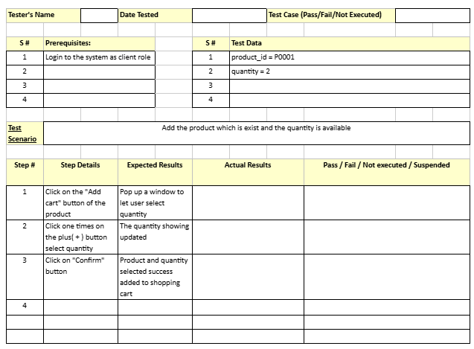
Add To Cart (Ong Yi Xin)
Positive Test Case

Slide 102
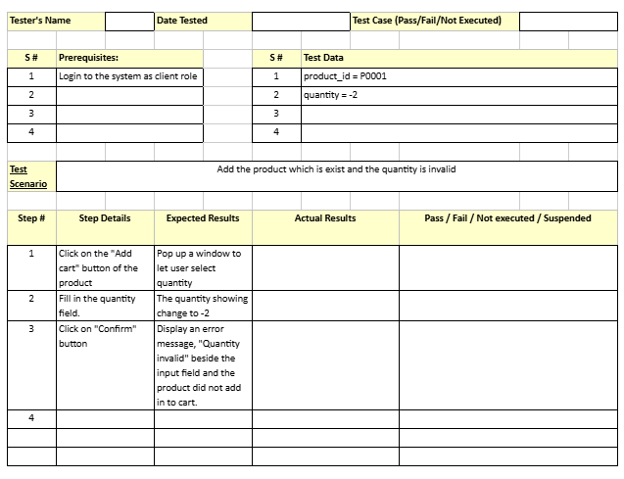
Add To Cart (Ong Yi Xin)
Negative Test Case

Slide 103
Add To Cart (Ong Yi Xin)
Negative Test Case

Slide 104
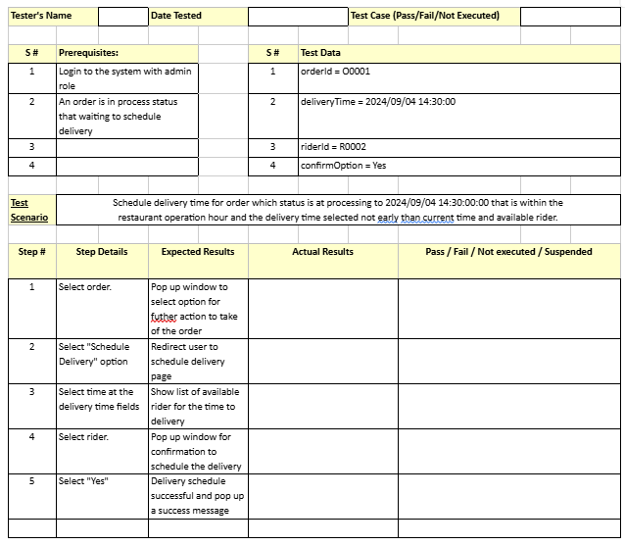
Schedule Delivery Time (Ong Yi Xin)
Positive Test Case

Slide 105
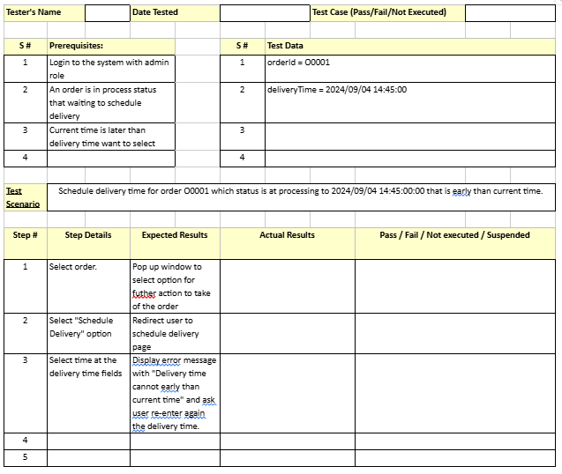
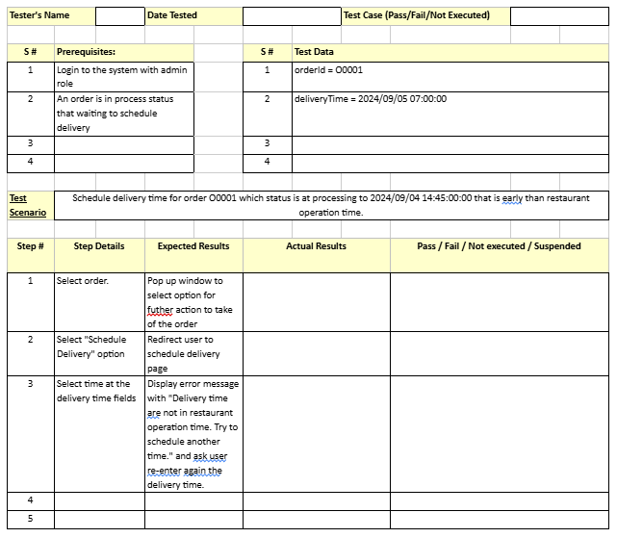
Add To Cart (Ong Yi Xin)
Negative Test Case

Slide 106
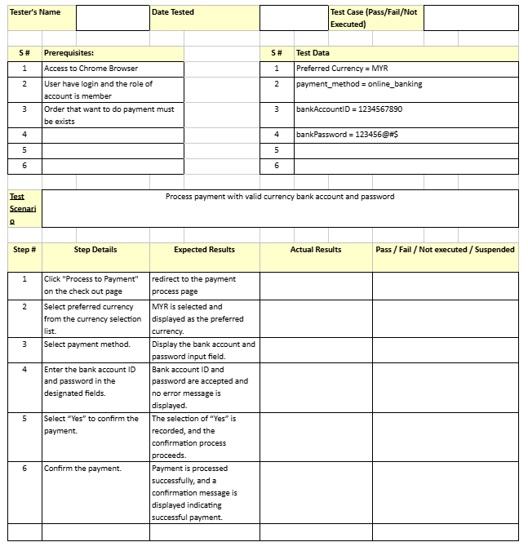
Process Payment (Chia Ming Yi)
Positive Test Case

Slide 107
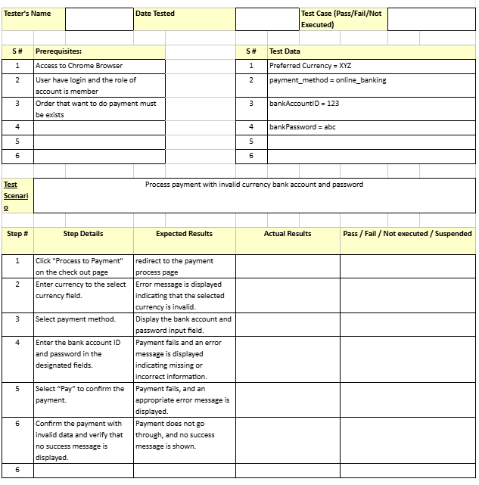
Process Payment (Chia Ming Yi)
Negative Test Case

Slide 108
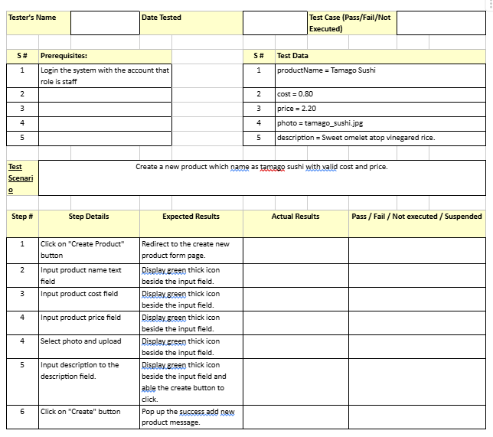
Create New Product (Chia Ming Yi)
Positive Test Case

Slide 109
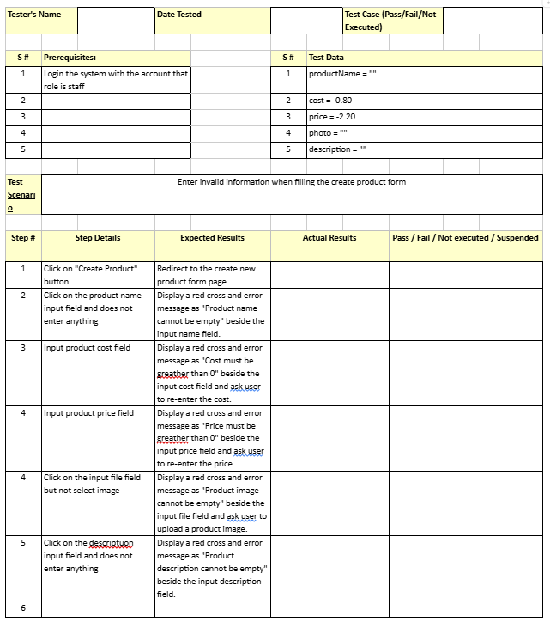
Create New Product (Chia Ming Yi)
Negative Test Case

Slide 110
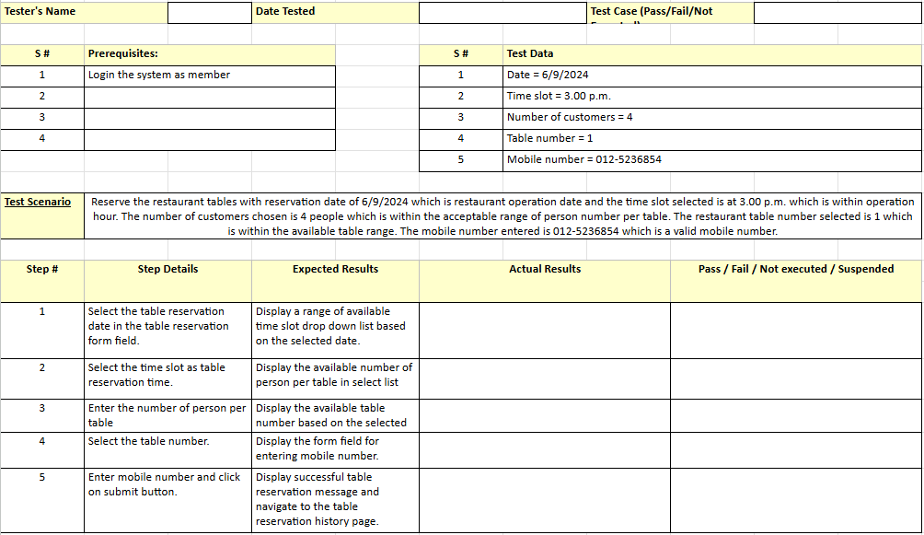
Reserve Table (Lim Jun Wei)
Positive Test Case

Slide 111
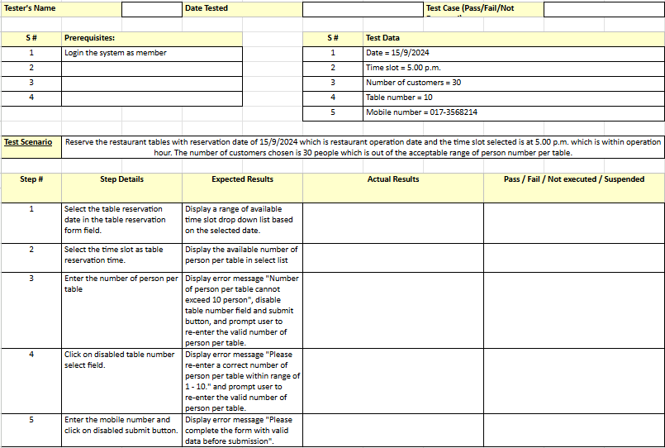
Reserve Table (Lim Jun Wei)
Negative Test Case

Slide 112
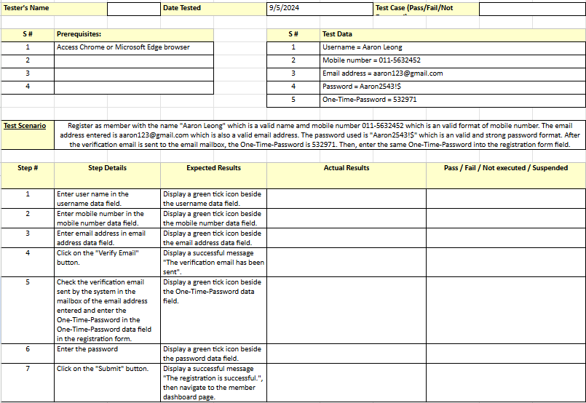
Register as Member (Lim Jun Wei)
Positive Test Case

Slide 113
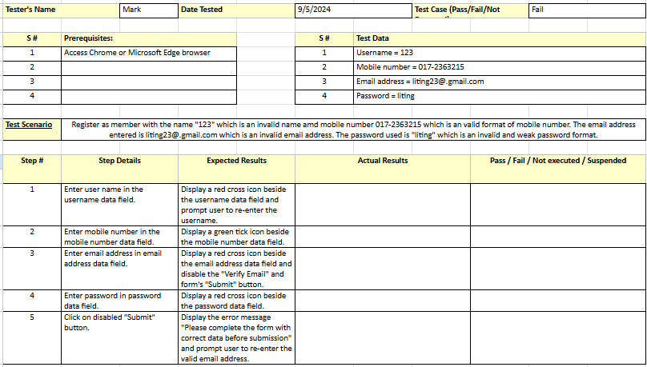
Register as Member (Lim Jun Wei)
Negative Test Case

Slide 114
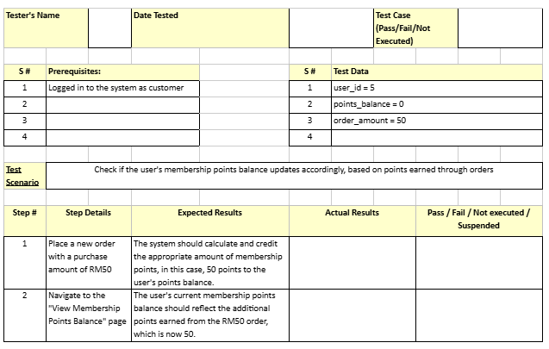
Update Membership Points Balance (Ng Ian Kai)
Positive Test Case

Slide 115
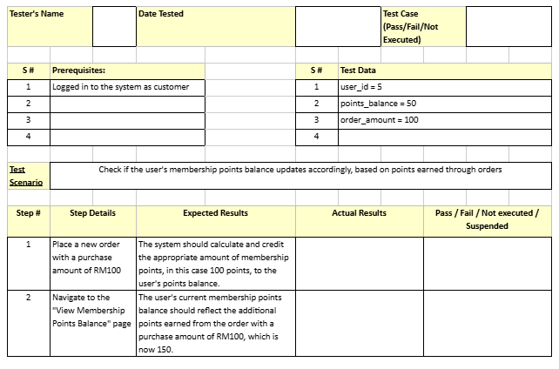
Update Membership Points (Ng Ian Kai)
Positive Test Case #2

Slide 116
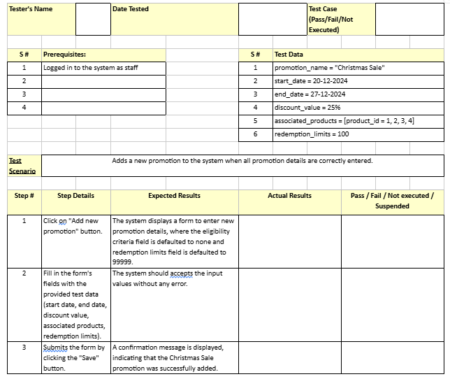
Add New Promotion (Ng Ian Kai)
Positive Test Case

Slide 117
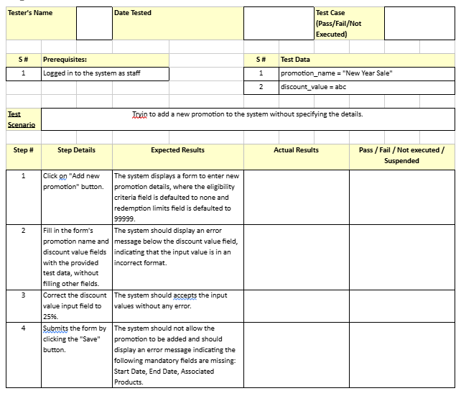
Add New Promotion (Ng Ian Kai)
Negative Test Case

Slide 118
3.4 UI Design Principles

Slide 119
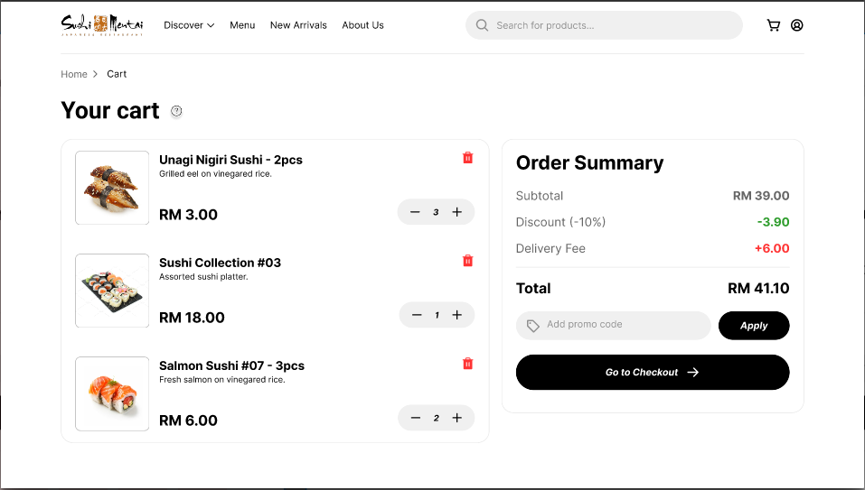
Ong Yi Xin (Modify Shopping Cart)
User Familiarity
Consistency
Recoverability
User Guidance

Slide 120
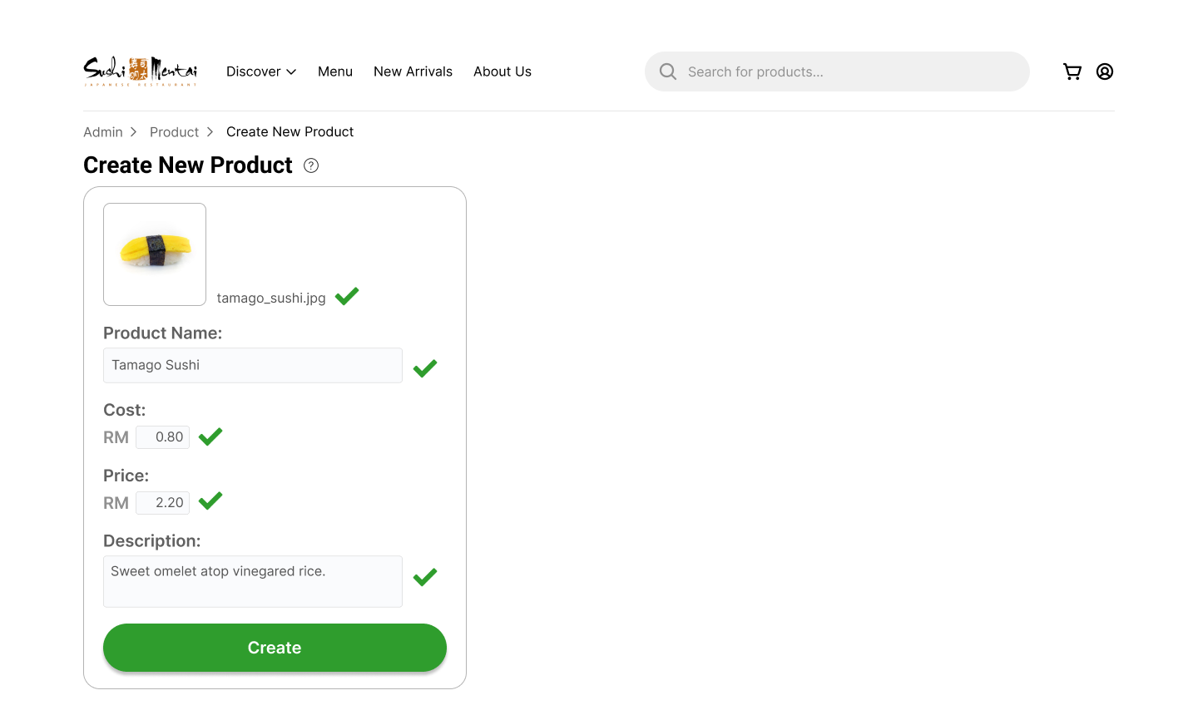
Chia Ming Yi (Create New Product)
User familiarity
Consistency
User Guidance

Slide 121
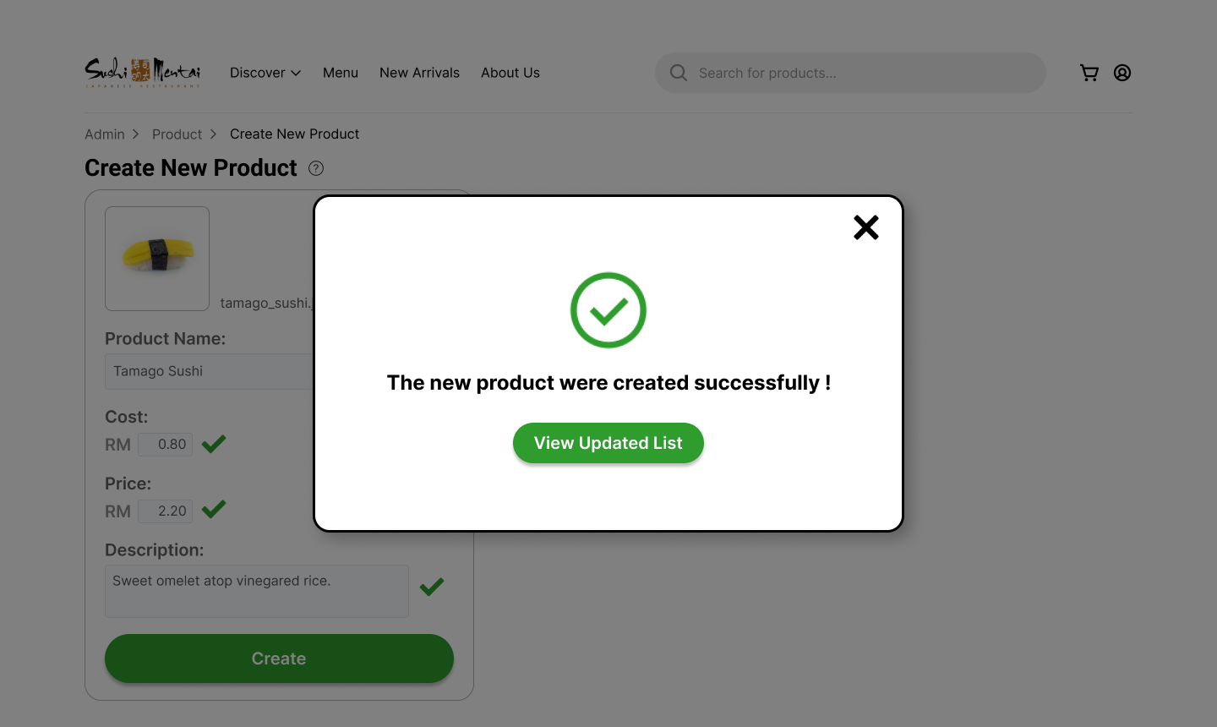
Chia Ming Yi (Create New Product)
Minimal Surprises

Slide 122
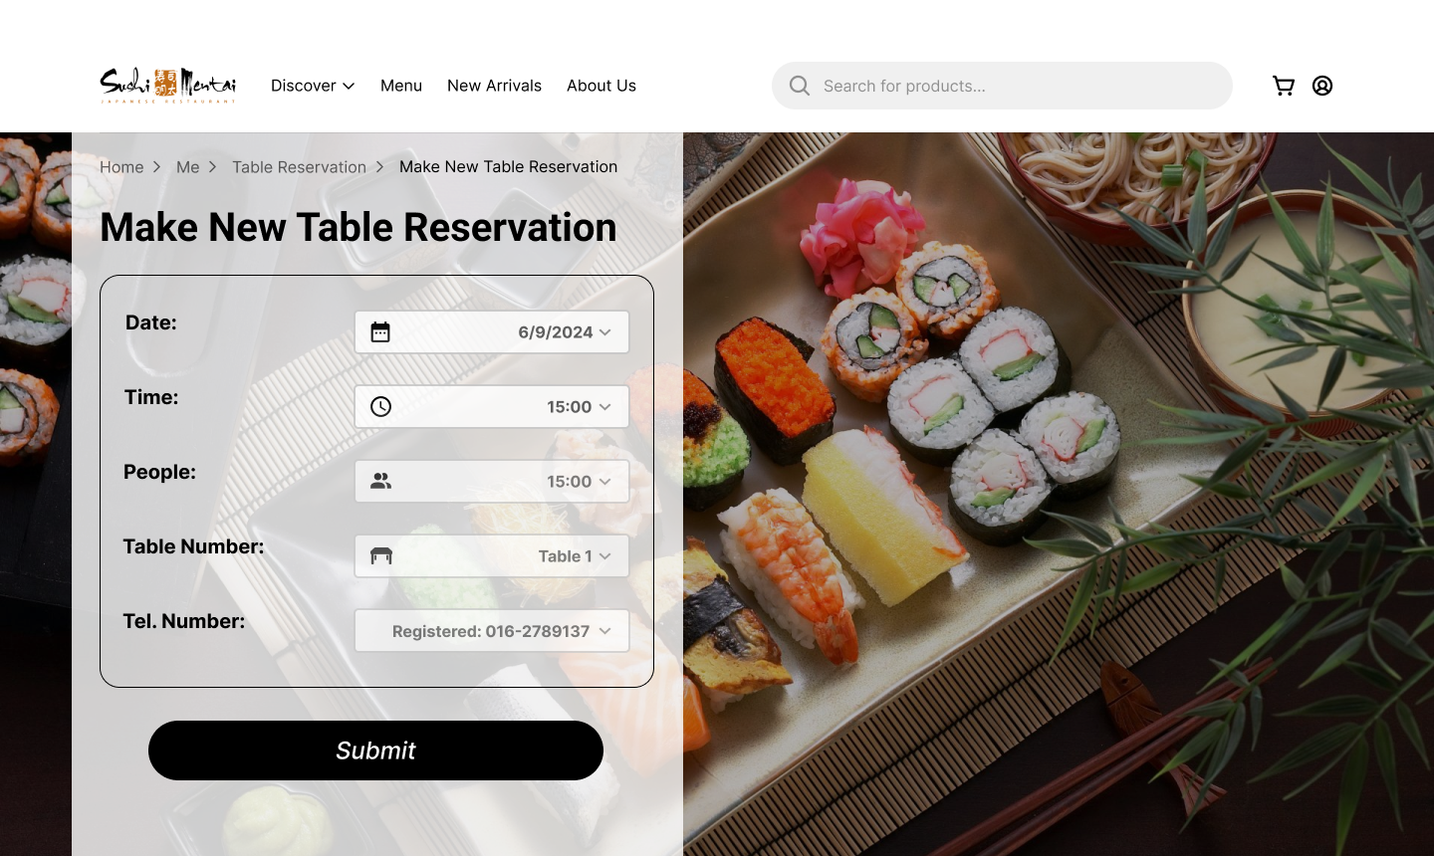
Lim Jun Wei (Table Reservation)
User Guidance
Consistency

Slide 123
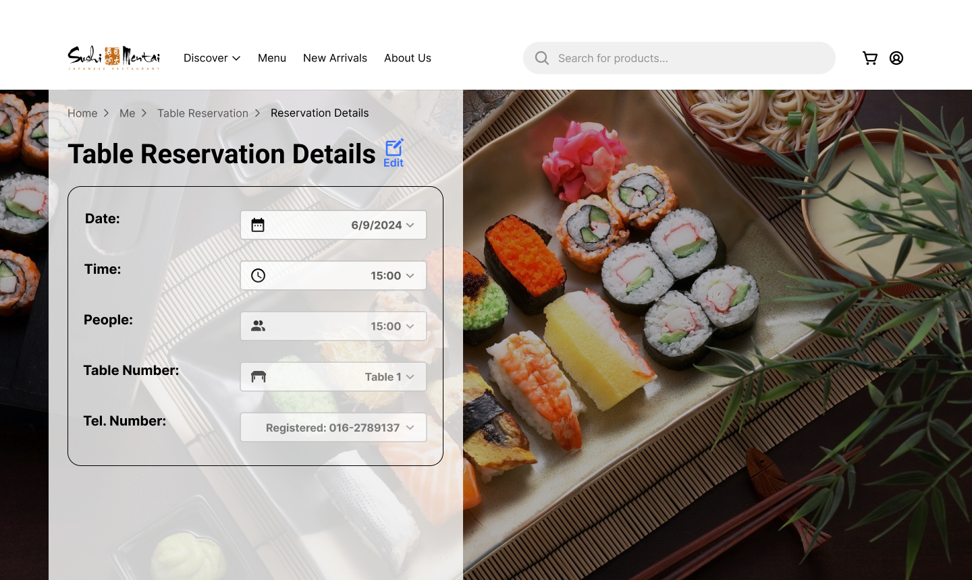
Lim Jun Wei (Table Reservation)
Recoverability

Slide 124
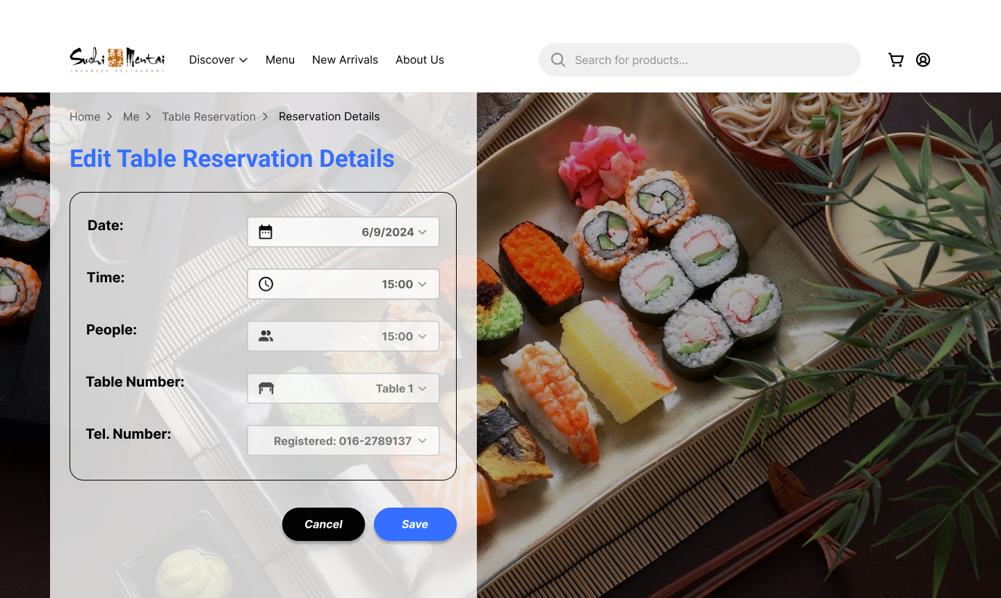
Lim Jun Wei (Table Reservation)
Recoverability

Slide 125
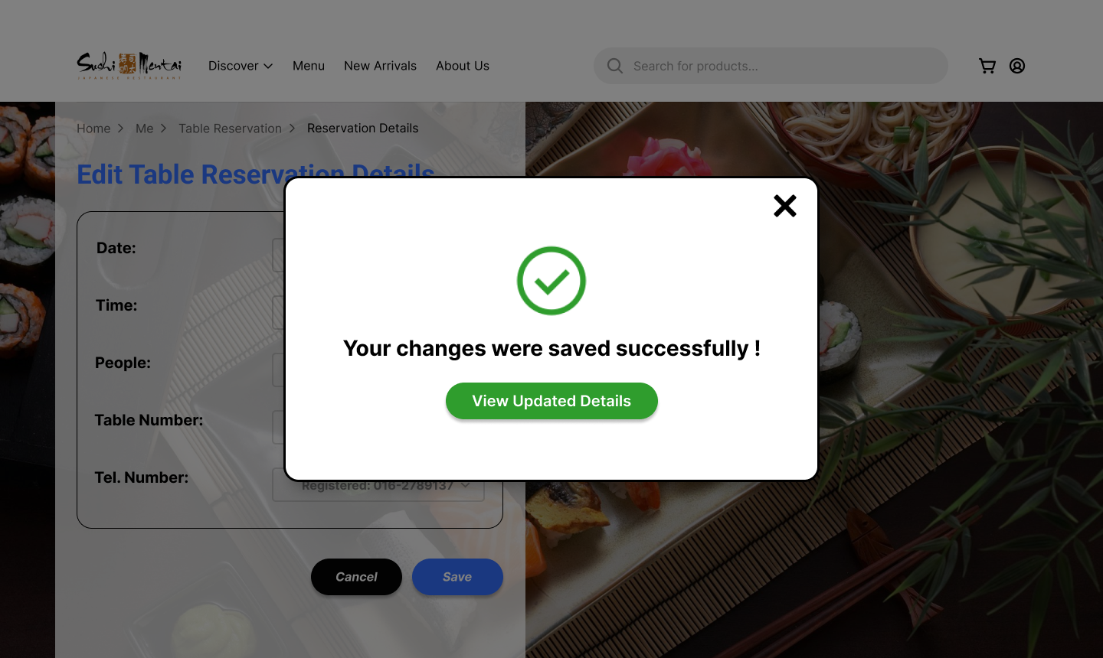
Lim Jun Wei (Table Reservation)
Minimal Surprise

Slide 126
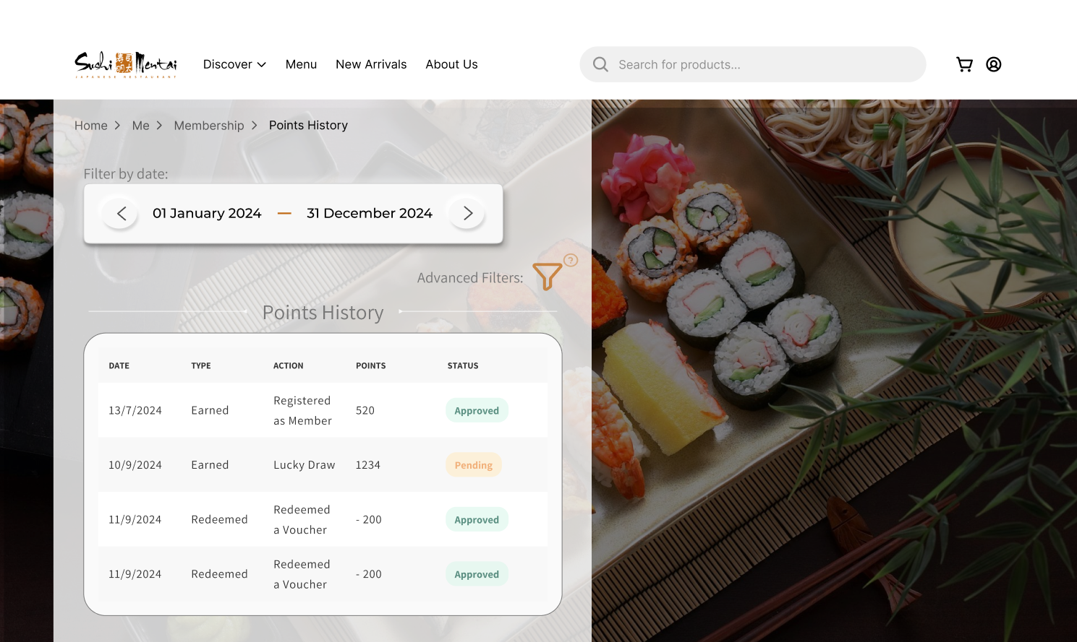
Ng Ian Kai (View Points History)
User Familiarity
User Diversity
User Guidance
Consistency

Slide 127
References

Slide 128
References
Adib. (2023, July 28). Jom kenali asal usul Sushi Mentai. Purple Durian. https://purpledurian.my/sejarah/jom-kenali-asal-usul-sushi-mentai/
Mentai, S. (n.d.). Sushi Mentai | 寿司明太. Sushi-Mentai.com. © Copyright 2024. Sushi Mentai. https://sushi-mentai.com/EN/our-restaurants
Suruhanjaya Syarikat Malaysia. (2024). Company profile. In SSM Search (pp. 1–6). https://storage.googleapis.com/prod-ssm-search-bucket/pdf/SUSHI_MENTAI_ENTERPRISE_SDN_BHD_FKR12B_EN_Company_Profile_17206727177402WINKX.pdf
David, E. (2020). 12 advantages & disadvantages of questionnaires. ProProfs Survey Blog. https://www.proprofssurvey.com/blog/advantages-disadvantages-of-questionnaires/
Bhasin, H. (2020, September 21). Questionnaire: Definition, characteristics & advantages. Marketing91. https://www.marketing91.com/questionnaire/
Indeed Editorial Team. (2023, March 11). 12 techniques for requirement gathering. Indeed Career Guide. https://www.indeed.com/career-advice/career-development/requirement-gathering-techniques
Jama Software. (2023). Requirements gathering techniques for agile product teams. Jama Software. https://www.jamasoftware.com/requirements-management-guide/requirements-gathering-and-management-processes/11-requirements-gathering-techniques-for-agile-product-teams
Unicommerce. (n.d.). Top challenges of order management system in e-commerce. https://unicommerce.com/blog/top-challenges-of-order-management-system-in-ecommerce/
Storfox. (n.d.). 16 online shopping problems and how to fix. https://storfox.com/blog/16-online-shopping-problems-and-how-to-fix/
Stratiis. (n.d.). IT issues with solutions. https://www.stratiis.com/blog/it-issues-with-solutions/
TechTarget. (n.d.). Replacing vs maintaining legacy systems. https://www.techtarget.com/searchcio/feature/Replacing-vs-maintaining-legacy-systems
Tutorialspoint. (n.d.). System analysis and design: Planning. https://www.tutorialspoint.com/system_analysis_and_design/system_analysis_and_design_planning.htm
ResearchGate. (n.d.). Chapter three: Analysis of existing systems. https://www.researchgate.net/publication/332180629_CHAPTER_THREE_31_Analysis_of_existing_systems
Module Testing. (2022, November 24). GeeksforGeeks. https://www.geeksforgeeks.org/module-testing/

